Slide 1
Sewage treatment
By Wendy Chai
Please read P309-311 on your textbook.

Slide 2
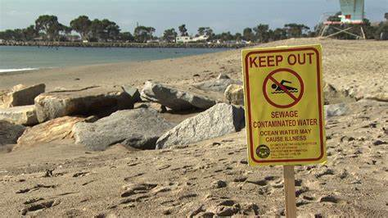

Conserve water - sewage treatment
What is sewage?
Waste liquid from houses (bathroom, kitchen), offices, industry and other parts of villages, towns and cities. Rain and other liquid that run off streets into drains.
So sewage contains mostly water, but also urine and feces, toilet paper, detergents, oil and many other chemicals, microorganisms (potential pathogens).
Raw sewage should not run into rivers before being treated.

Slide 3
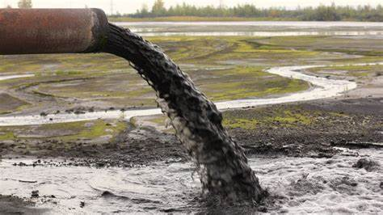
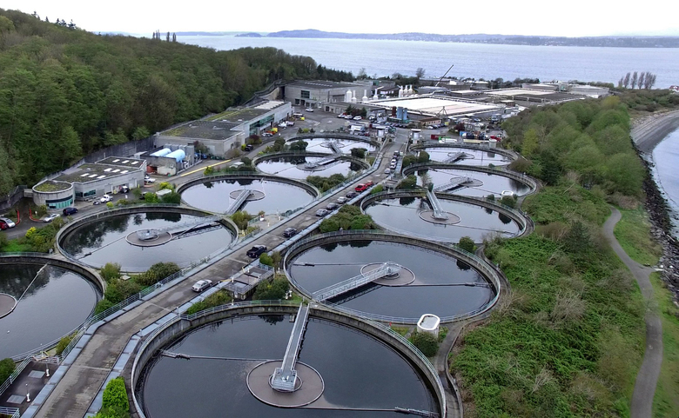
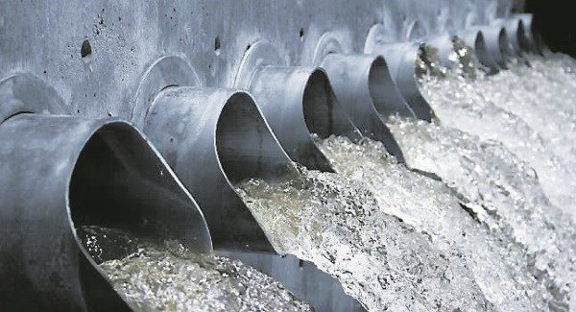
Sewage treatment plant

Slide 4
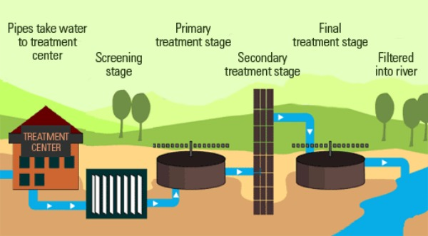


Sewage treatment
Step 1. Screening
Remove large objects like stones, grit by screens
Settlement tank: other smaller insoluble particles form a sediment and is removed

Slide 5
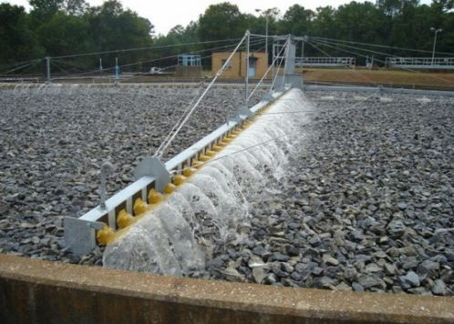
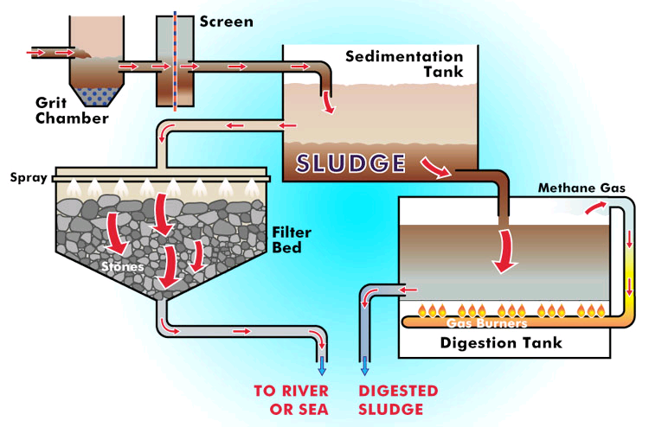

Sewage treatment
Step 2. A) Trickling filters
The resulting liquid is sprinkled over a trickling filter bed, which is a stack of small stones and clinker covered by many different aerobic microorganisms including bacteria, protoctists and fungi.

Slide 6
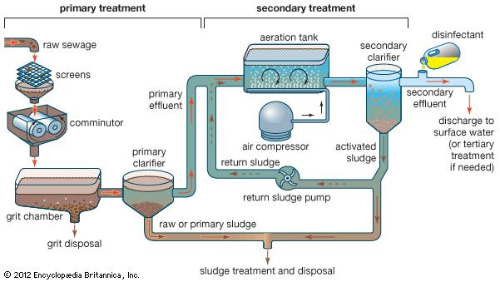

Sewage treatment
Step 2. B) Activated sludge

Slide 7
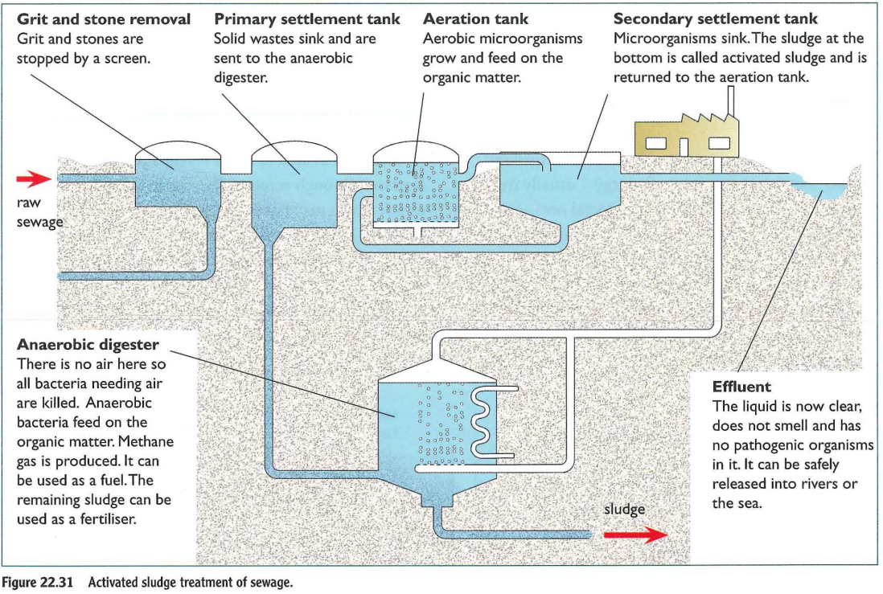


Slide 8
Sludge

Slide 9
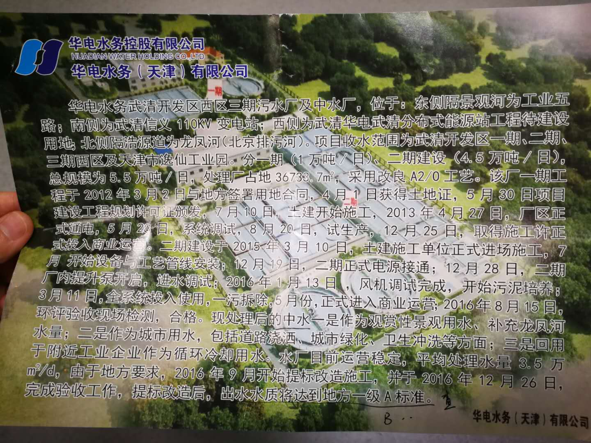

Slide 10
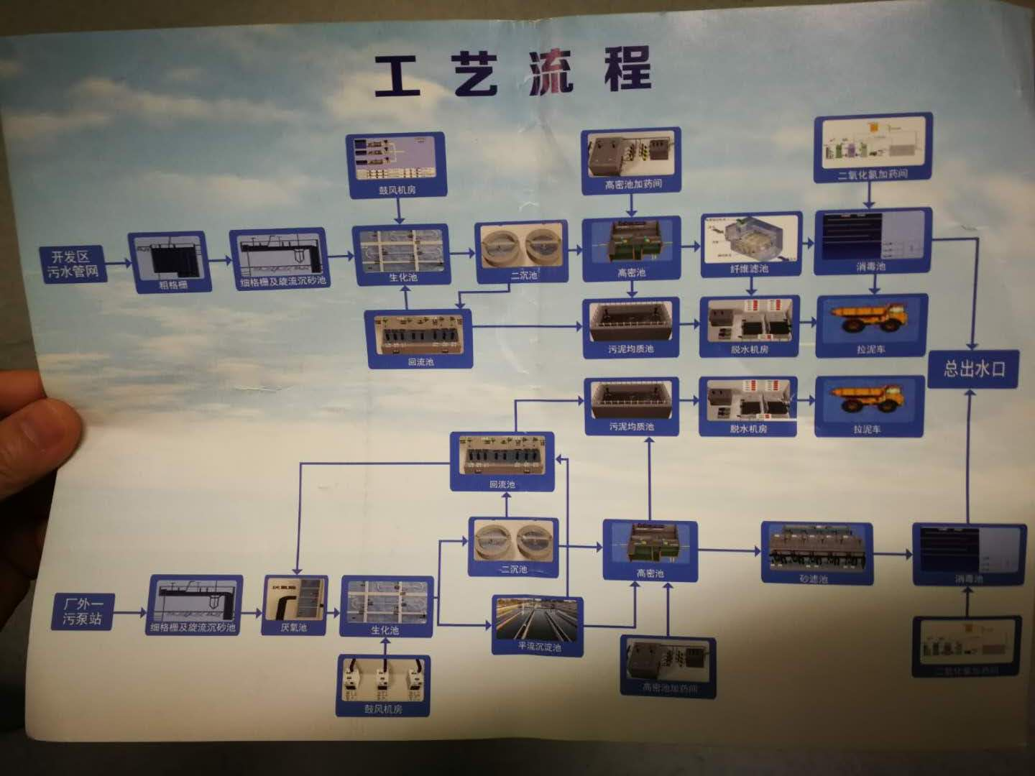

Slide 11
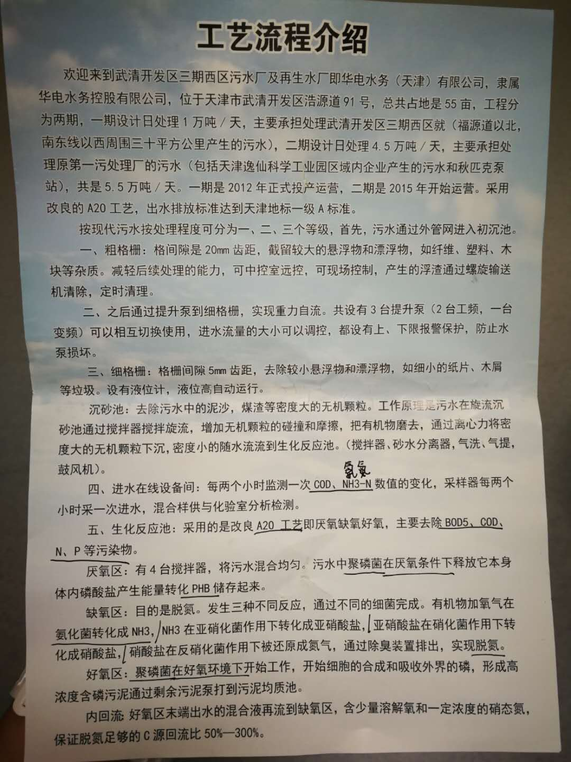

Slide 12
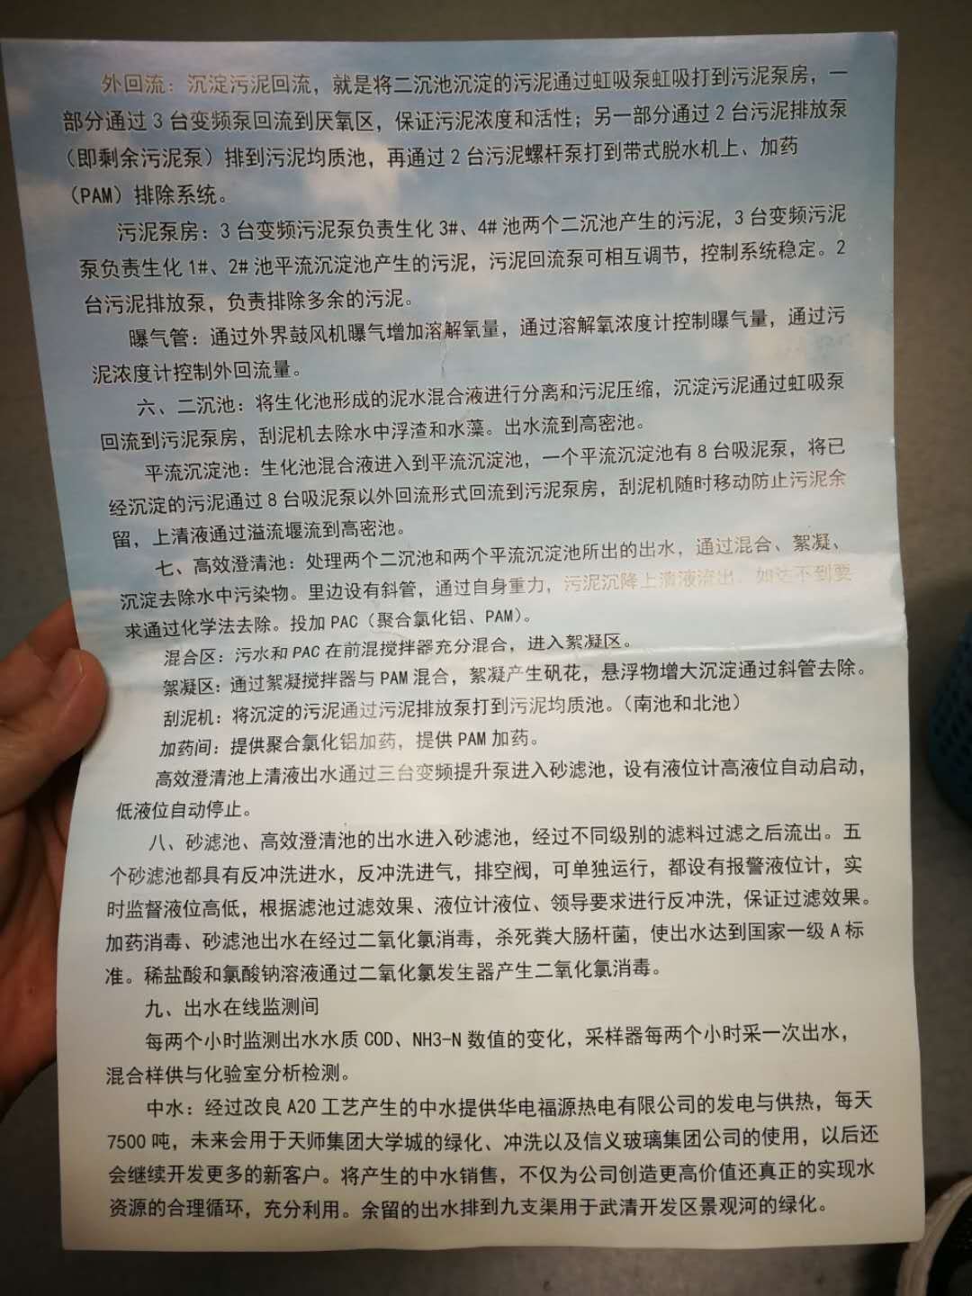

Slide 13
The end

